Slide 1


DevOps at Blue Shield of California Dealing with Complex Integrated Environments and Databases
Blue Shield of CA
Michael Hrenko
Lead Automation Engineer
10-21-2015

Slide 2


About Blue Shield of CA
Blue Shield of CA is a not for profit health plan provider founded in 1939
Serving 3.5 million members and over 65,000 physicians throughout California
Over 9 billion in revenue
Over 300 deployable application components
Large databases with personal health information
Notes:
5 min - tell me about the organizations (10m)
Dependencies amongst multiple components
Multiple technologies across dependent components
Multiple releases simultaneously
Multiple projects within a release
Regulated/Mandates

Slide 3

About me
Lead Automation Engineer
Background in Software Delivery Lifecycle
Infrastructure
Application development
System integration
Geek
Notes:
5 min - tell me about the organizations (10m)
Been with the company 6 years
Worked on SCRM team to deploy new defect and source control software
Worked on release management team
Worked on SCRM automation and test automation teams
Worked in infrastructure team
Home automation, gadgets, lab environment/server room

Slide 4

Challenges
“Healthcare applications don’t lend themselves to automation”
“Facets is too complicated and there are too many dependencies“
“DevOps is confusing and we have more important things to do”
“It takes too long to get ________ done”
Data refreshes
Environment refreshes
Testing
Notes:
5 min. - problems being experienced, ideally with metrics around deployment lead time
Lots of teams with manual handoffs between them (Entrenched functional silos)
A single environment can take upwards of 2 weeks to make operational
Multiple standards being supported
Headcount driven coping mechanism
Environment inconsistency (configuration, code, data)

Slide 5

Dispel the myths
Greenfield
Visible application
Don’t choose something too complicated
Practice DevOps – partner with infrastructure and appdev
Road show
Notes:
5 min - what specific business process or application were you focused on? where did you start?
Started with Provider Portal
Web application based on WAS
Backend oracle database
Full stack automation, no handoffs
Promote and get excitement

Slide 6

How we did it
Push button environment build with automated smoke testing
Database as a service (Delphix)
Configuration management (Puppet)
Automated testing (ALM/QTP/Jtest/Veracode)
IaaS (VMware)
Continuous Integration/Deployment (Jenkins/Nexus)
DevOps
Notes:
10 min. - what you did about it
Full stack automation, no manual intervention no manual handoffs
* Virtual machine creation – Hardening, monitoring, backup, network, storage
* Middleware installation and configuration
* Loading static content from content management system
* Loading application code
* Database creation from baseline
* Initiate application deployment

Slide 7

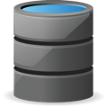





Solving for the database
Current Process: 3 DAYS
Mon |  |  | Tues |  |  | Wed
Request submitted |  |  | Restore blue copy backup set, apply archived redo log |  |  | Execute post-refresh script
Multiple admins,
manual processes.
Database as a Service: 5 MIN
Mon |  |  | Tues |  |  | Wed
Reset
Self-service,
automated.
Bookmarks
WPR
10:27:36 A.M.
1:30:20 P.M.
5:07:15 P.M.
Set checkpoints, reduce risk of errors
Eliminate impact of downtime with ability to reset in minutes
Enable time-sharing of environments with bookmarks
FACETS
TIDAL
Reset
Reset
5 MIN
5 MIN
Notes:
5 min. - what you did about it
Describe how this changes testing paradigm
Testers can bookmark databases before and during tests
Testers can retest from any bookmark
Projects can timeshare databases to give them greater isolation
Databases can be stood up with smaller scale “stand alone” environments for project specific work

Slide 8
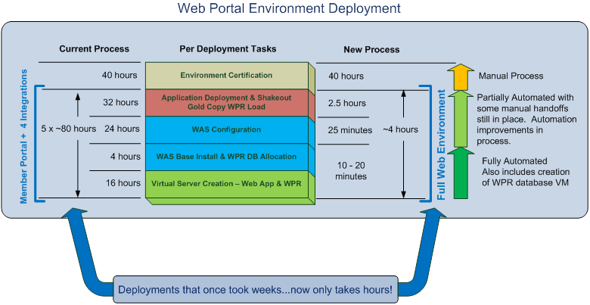
The impossible is possible
Notes:
5 min. - what you did about it

Slide 9

Moving forward
Brownfield approach – Increase speed and agility of existing environments
Uplift existing environments using config management “infrastructure as code”
Virtualize existing databases for fast rollback and “data as code”
Automated testing (unit and smoke)
Notes:
5 min. - what you did about it
Uplift skillset
Move out of firefighting mode
See immediate wins
Free up resources for more value add work
Automated testing:
Unit testing
Functional testing
Smoke testing

Slide 10

Business Value
More time to spend on “value add” work
Reduce dev/qa downtime due to
Environment inconsistency
Configuration issues
Data issues
Service enablement
Environment provisioning
Database rollback and bookmarking
Continuous integration and testing
Notes:
10 min. - the business value that was created

Slide 11
Top Five Takeaways
DevOps can be achieved in large healthcare organizations
Large problems can be broken down into solvable chunks
Challenges need to be addressed holistically (people and technology)
Get excitement with a big win
Chip away at the biggest time sinks and shift resources to more value add work
Notes:
4 min.

Slide 12
Here’s what I’m looking for help with
Automated testing
Tidal batch
Facets
Test data management
Key performance indicators (KPI)
Notes:
4 min.
* KPI, what should we be measuring?

Slide 13
Questions?
Notes:
2 min.

